Slide 1
Transform and Visualize
REDCap + R Workshop
REDCapCon 2023

Slide 2
10 Minute Intro to the Tidyverse

Slide 3
The Data Analysis Pipeline
Notes:
This diagram may look familiar, you saw it in the Welcome presentation.
The first step in the data analysis pipeline is to load the data into the environment so we can begin to tidy and transform that data.
In today’s course we will be using a de-identified data set consisting of COVID-19 laboratory test results from a microbiology lab. This data is stored as a CSV file.

Slide 4
Tidyverse: R Packages for Data Science
A consistent way to organize data
Human readable, concise, consistent code
Build pipelines from atomic data analysis steps
Notes:
To import our CSV data, we need some additional data analysis tools. In this course, we will be leveraging the Tidyverse.
The Tidyverse is a modern set of tools for data analysis in R. It’s quickly becoming the de facto standard for doing data science with R.
The basic tenets of “tidy” data analysis include:
Data should be organized in a consistent, standardized way. Each row is an observation, and each column is a variable. This is a very common way to organize data in a spreadsheet and might sound familiar from how you may already organize data in tools like Excel.
Programming code that acts on the data should be consistent, concise, and mimic the narrative language as much as possible.
Each data analysis can be broken down into a series of atomic steps, such as “select this column” or ”arrange the data by the values in that column”. An arbitrarily complex data analysis can be broken down as a pipeline of atomic steps.

Slide 5
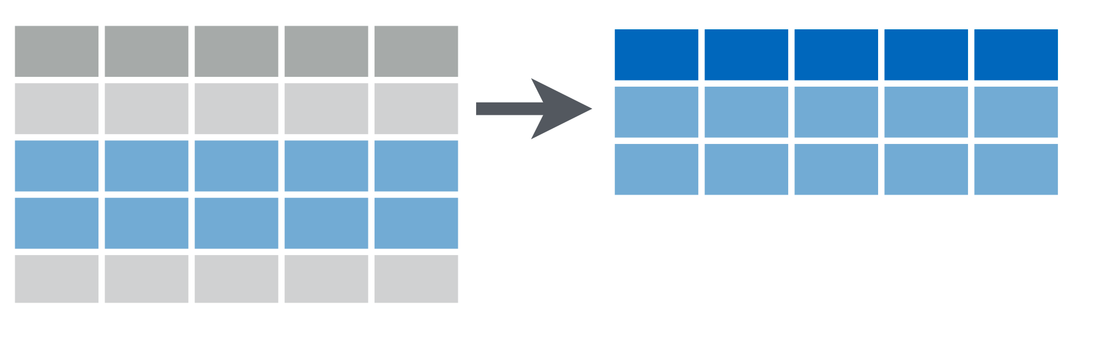
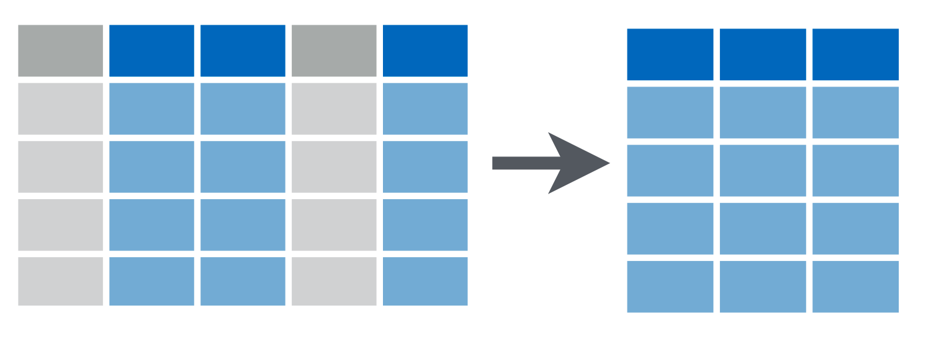
filter(data, condition)
keep rows that match a condition
logical test (return each row for which the test is TRUE)
select(data, columns)
keep or drop columns using their names
column names select multiple by separating with commas;
drop instead of keep by prefixing column names with “-”

Slide 6
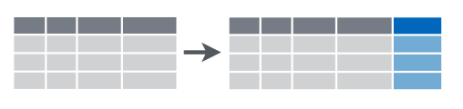
mutate(data, col = expr)
Creates calculated columns
pipe operator
(“then”)
data |>
filter(condition) |>
select(columns) |>
mutate(col = expr) |>
...
Chain tidyverse commands into a pipeline

Slide 7
The Pipe Operator |>
redcart |> filter( , structure == "repeating")
Passes the object on the left as first argument to the function on the right.
filter(redcart, structure == "repeating")
Notes:
The pipe operator takes the object on its left - here the covid_testing data frame - and ** plugs it as the first argument of the function on its right - here as the first argument to the filter function.
** So if you look at the first line of code here – a filter function where the first argument is the covid_testing data frame that we’re passing in – we can re-write this as covid_testing pipe filter(pan_day <= 10)
Those two lines of code are equivalent. In both cases we’re covid_testing gets passed as the first argument to the filter() function.

Slide 8
Your Turn
Rewrite the following statement with a pipe:
select(mydata, first_name, last_name)
Take one minute to discuss with your neighbor!

Slide 9
Notes:
We’ll be using the ggplot2 package for creating graphics. ggplot2 is part of the tidyverse so it will get loaded when you load the tidyverse package.
GGplot provides a "grammar of graphics" for data visualization. The idea of having a “grammar” for something is actually pretty common in R (esp. tidyverse) and we’ll revisit this in the session on data transformation. Essentially, there should be a consistent way to build a any type of graph. This makes it easier to learn and also easier to for humans to read the code later and make sense of it. And that’s super important because most people who use R are not programmers.
The idea of the grammar of graphics basically boils down to this. For any graph - you should be able to specify any type of graph by specifying the data that goes into it, the type of graph that you want to make, and a mapping that describes how the data should be represented as visual marks on that graph.
Having a consistent grammar means that once you learn how to make a histogram that knowledge can be applied to make a scatter plot with little extra effort. This makes it easy to generate lots of different graphs quickly which helps you understand your data more quickly.
Also, ggplot2 graphs look great and can be used to generate publication-quality plots.

Slide 10
To make any kind of graph:
1. Pick a “tidy”
data frame
ggplot(data = data_frame) +
geom_function(mapping = aes(mappings))
3. Write aesthetic mappings
Use the ggplot template!
Notes:
So that was a lot of information. Let’s repeat and look at this from a slightly more general perspective. Here’s a template for making any kind of graph with ggplot2. And you can use the ggplot template to start making any kind of graph. Here’s how you use it.
You start with the code written in black – black is constant part - and fill in the details written in blue.
The first detail is a tidy data frame <- this contains the data you want to plot.

Slide 11
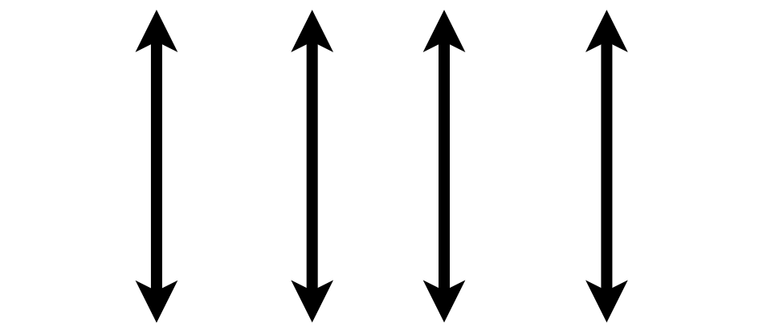

1. Pick a “Tidy” Data Frame
A data set is tidy if:
Each variable is in its own column
Each observation is in its own row
Each value is in its own cell
Wickham H. Tidy Data. J Stat Soft 2014.
Notes:
What do I mean by “tidy” data frame?
A data set can take on a lot of different shapes. But there is one shape that is best suited for data analysis, and that shape is called ”tidy.”
A data set is tidy if: each variable is in its own column,
Each observation is in its own row, and
Each value is in its own cell.
The opposite of “tidy” is often called “messy.” And often times a lot of the data analysis work is to convert “messy” data into “tidy data.” But for now, fortunately for us, the covid_testing data set is tidy already. It’s already in this shape – (…) e.g. pan_day is a column, … obs = lab test

Slide 12
1. Pick a “tidy”
data frame
ggplot(data = data_frame) +
geom_function(mapping = aes(mappings))
2. Pick a “geom” function
Notes:
The next step is to pick a geom function… this is how you tell R what kind of plot you want to create.

Slide 13
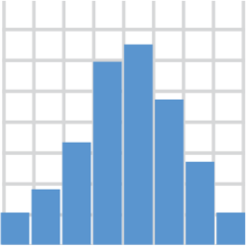
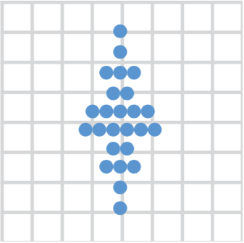
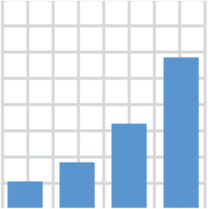
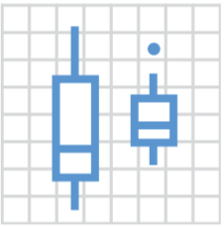
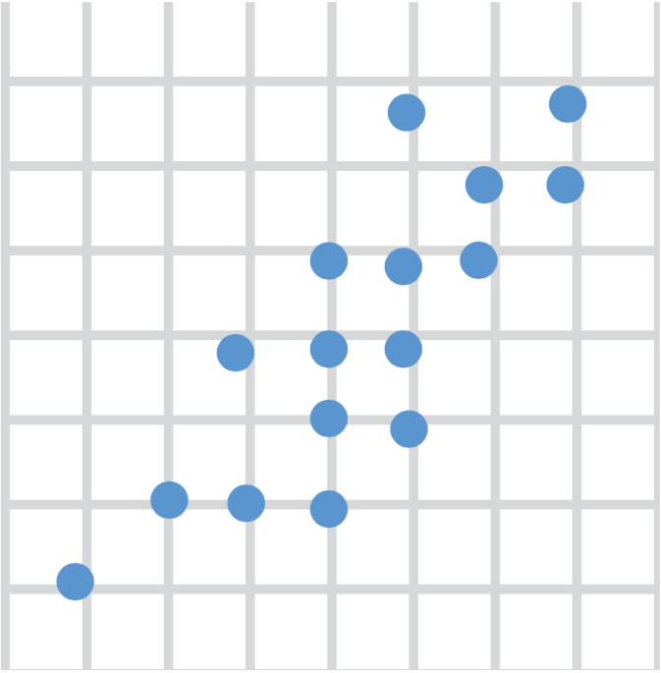
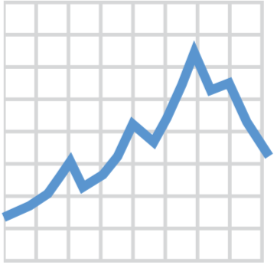
2. Pick a “Geom” Function
geom_histogram()
geom_dotplot()
geom_bar()
geom_boxplot()
geom_point()
geom_line()
Notes:
We’ll go into more detail about what geom functions are, but for now, just know that you need to tell ggplot what type of graph you want, and you do that by picking the right geom_ function.
Here are a couple of useful geom functions for visualizing clinical data, but there are many more. With these 6 you can make histograms, bar plots, scatter plots, dot plots, boxplots, and line graphs.

Slide 14
1. Pick a “tidy”
data frame
ggplot(data = data_frame) +
geom_function(mapping = aes(mappings))
2. Pick a “geom” function
3. Write aesthetic mappings
Notes:
The third and last step is to write “aesthetic mappings”. This is where you tell R how you want the columns of the data frame represented as graphical markings on the plot.

Slide 15
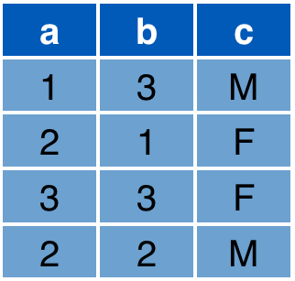
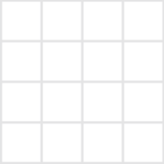
3. Write Aesthetic Mappings
aes(x = a, y = b, color = c)
Data frame
Graph
y
x
Notes:
So what's an aesthetic and what’s an aesthetic mapping?
An aesthetic is a thing that we can perceive about a specific data element on a graphic, such as its position on an x/y grid, but also other features such as for example its color. It’s not just anything that’s visible like a title or font, it needs to be something that can vary with each observation.
An aesthetic mapping is how you tell R how you want to visually represent each columns of a data frame on the plot. So you map a column to an aesthetic such as a x/y position or color or what have you.
For example: look at this data frame here. It has 3 columns: a, b, and c. And then look at this x/y grid, that’ll be our graph.
The aesthetic mapping above defines that x axis position of each marking should be derived from the "a" column
The y axis position from the "b" column
And that the color should come from the "c" column.
As a result, you get the following graph, which visually encodes all the information from those 3 columns in the data frame. (R automatically figures out reasonable axis limits and a color scale, but you can manually fine tune this manually.)
So this is what aesthetic mappings are. They are a list of these expressions, separated by commas, that connect some aesthetic, e.g. x position, with a column of a data frame, e.g. a in this example.
Aesthetics are a powerful and fundamental concept in the grammar of graphics so let’s do a quick Your Turn to explore this idea a little further.

Slide 16
To make any kind of graph:
1. Pick a “tidy”
data frame
ggplot(data = data_frame) +
geom_function(mapping = aes(mappings))
2. Pick a “geom” function
3. Write aesthetic mappings
Notes:
So let’s recap. To make any kind of graph, use the ggplot template! And then…
Choose a tidy data frame (this contains the data you want to plot),
Pick a geom function (this is the type of plot you want to create), and
Write aesthetic mappings (this is where you map data columns to position, color, and other features of the graph)

Slide 17
Your Turn
Open the 02_transform_visualize.qmd file in the exercises folder.
Read what it says and follow the instructions to complete the exercise.

Slide 18
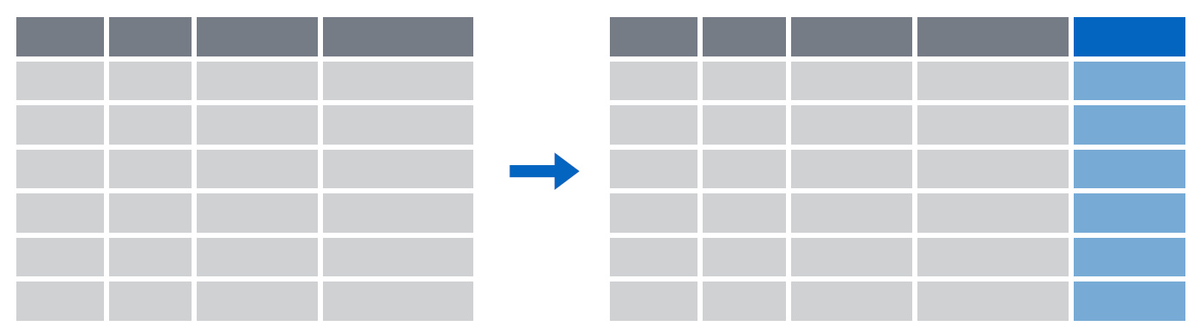
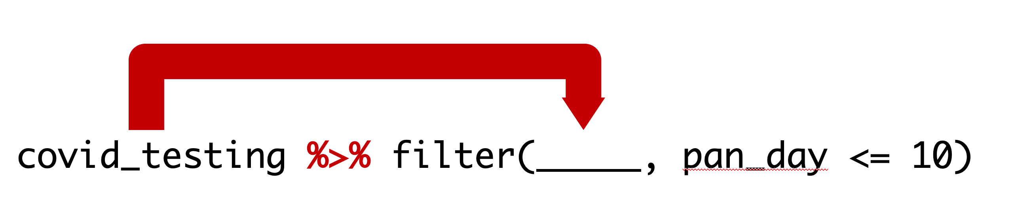
Recap
select() subsets columns by name
filter() subsets rows by a logical condition
mutate() creates new calculated columns
Use the pipe operator |> to chain functions into a pipeline
Notes:
To recap, dplyr provides a grammar for transforming data frames. Some of the key dplyr functions are:
** select(), which subsets columns by name;
** filter(), which subsets rows by a logical condition; and
** mutate(), which creates new calculated columns.
** The pipe operator, written %>%, can be used to string together dplyr functions into a pipeline.

Slide 19
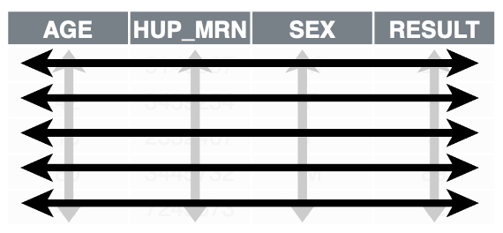
Recap
ggplot2 is a package that provides a grammar of graphics. You can create any type of plot using a simple template to which you provide:
1. A tidy data frame, in which each variable is in its own column, each observation is in its own row, each value is in its own cell;
2. A geom function, which tells R what kind of plot to make; and
3. Aesthetic mappings, which tell R how to represent data as graphical markings on the plot.
Notes:
** Lots of info - provide reassurance **
To recap:
…

Slide 20
What else?
Notes:
The “What Else?” section should mention things that would be covered in a comprehensive course and/or are of strong interest to the intended audience

Slide 21
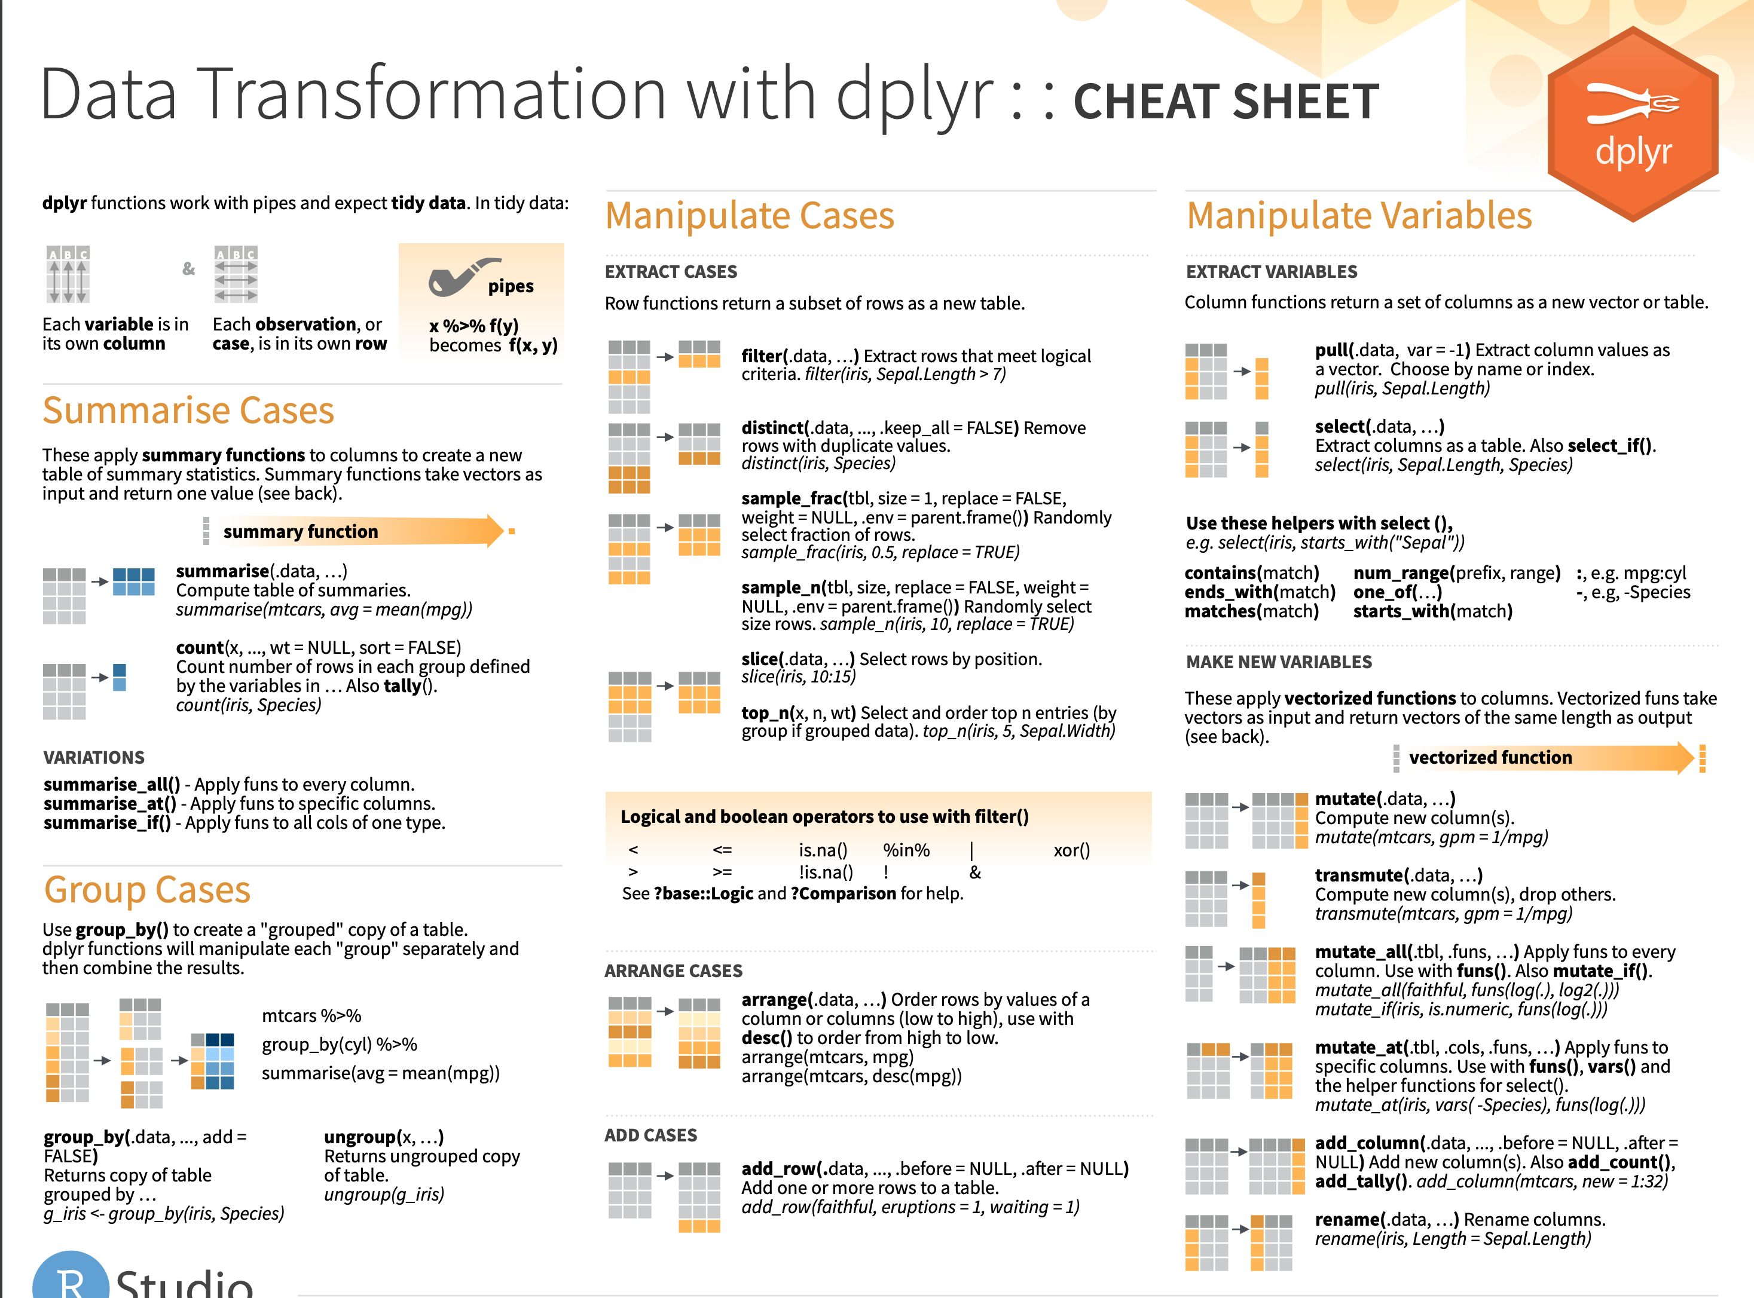
Notes:
There is a dplyr cheat sheet which gives a great overview of those functions. I’ve linked it on the course website.

Slide 22
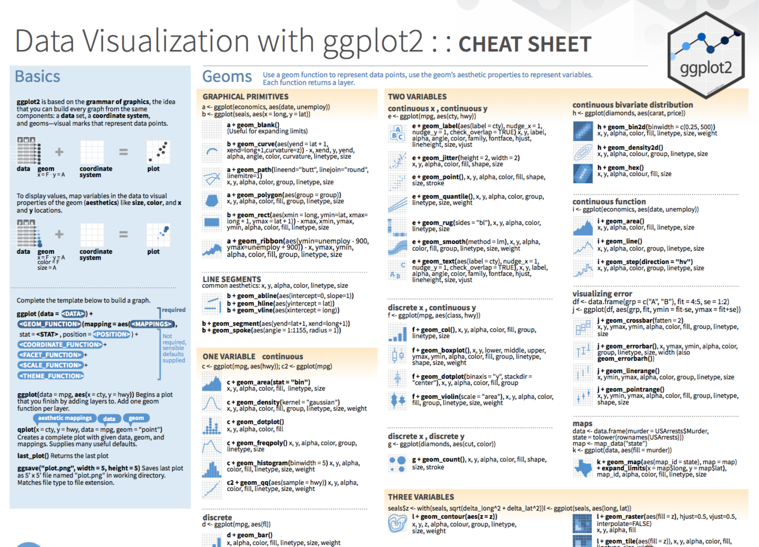
Notes:
The ggplot Cheat Sheet – and I’m going to ask our TAs to drop the link in the chat - is great to have on hand as you’re exploring your data. It reviews the basic template for building any plot and also lists the most useful geom functions. And it looks like Posit has made a more HTML version of this which is maybe a little bit less overwhelming.
https://rstudio.github.io/cheatsheets/data-visualization.pdf
https://rstudio.github.io/cheatsheets/html/data-visualization.html

Slide 23
Notes:
Beyond dplyr, there are a number of other packages that provide powerful tools for data transformation
Tidyr provides a lot more functions like dplyr that allow you to convert messy data frames into tidy ones
Lubridate provides functions to manipulate times and dates
Stringr provides tools for manipulating pieces of text
Purrr offers advanced functionality to automate complex data transformations
And Dbplyr allows you to interact with a table inside a database as if it were a data frame.

